Slide 1
Chapter 23 Minimum Spanning Trees
Chi-Yeh Chen
陳奇業
成功大學資訊工程學系

Slide 2
Overview
Problem
A town has a set of houses and a set of roads.
A road connects 2 and only 2 houses.
A road connecting houses u and v has a repair cost w(u, v).
Goal: Repair enough (and no more) roads such that
1. everyone stays connected: can reach every house from all
other houses, and
2. total repair cost is minimum.

Slide 3
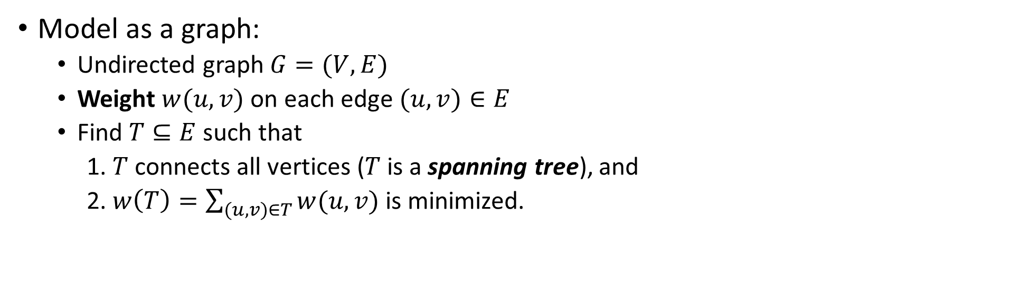
Overview
Model as a graph:
Undirected graph $G=(V,E)$
Weight $w(u,v)$on each edge $(u,v)∈E$
Find $T⊆E$such that
1. $T$ connects all vertices ($T$ is a spanning tree), and
2. $w\left(T\right)=\sum_{(u,v)∈T}{w(u,v)}$ is minimized.

Slide 4

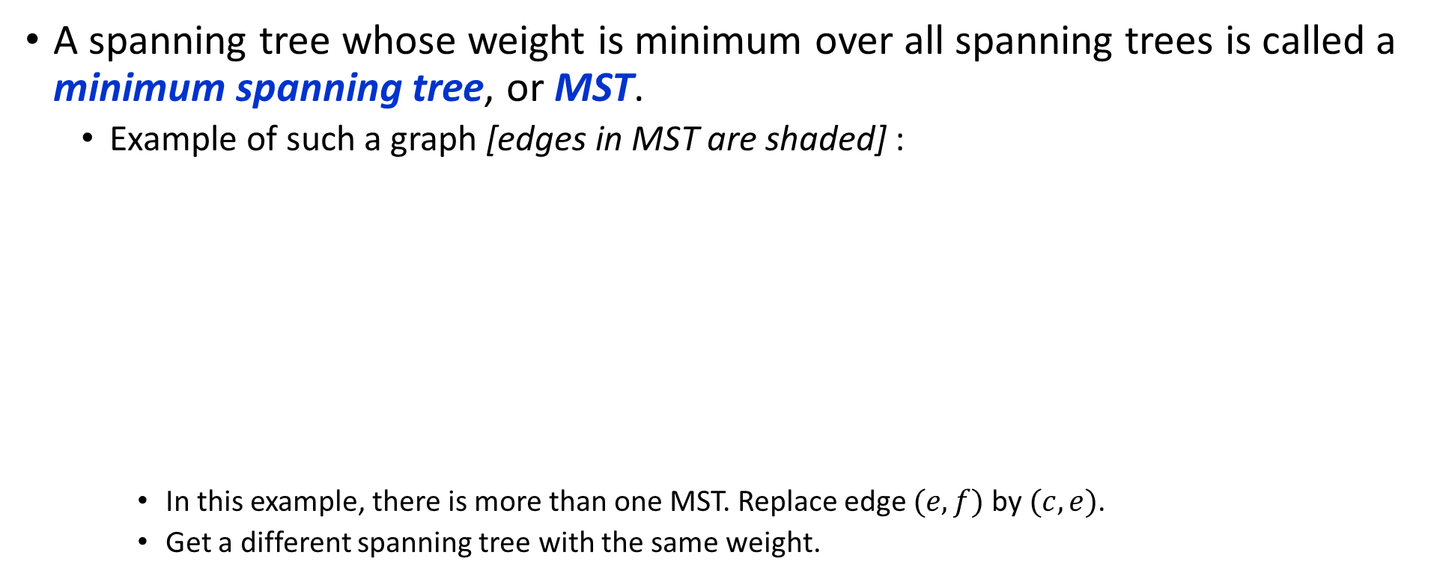



Overview
A spanning tree whose weight is minimum over all spanning trees is called a minimum spanning tree, or MST.
Example of such a graph [edges in MST are shaded] :
In this example, there is more than one MST. Replace edge $(e,f)$by $(c,e)$.
Get a different spanning tree with the same weight.
8
8
b
d
g
10
2
7
e
5
a
9
i
9
3
3
12
11
c
f
h
1
6

Slide 5
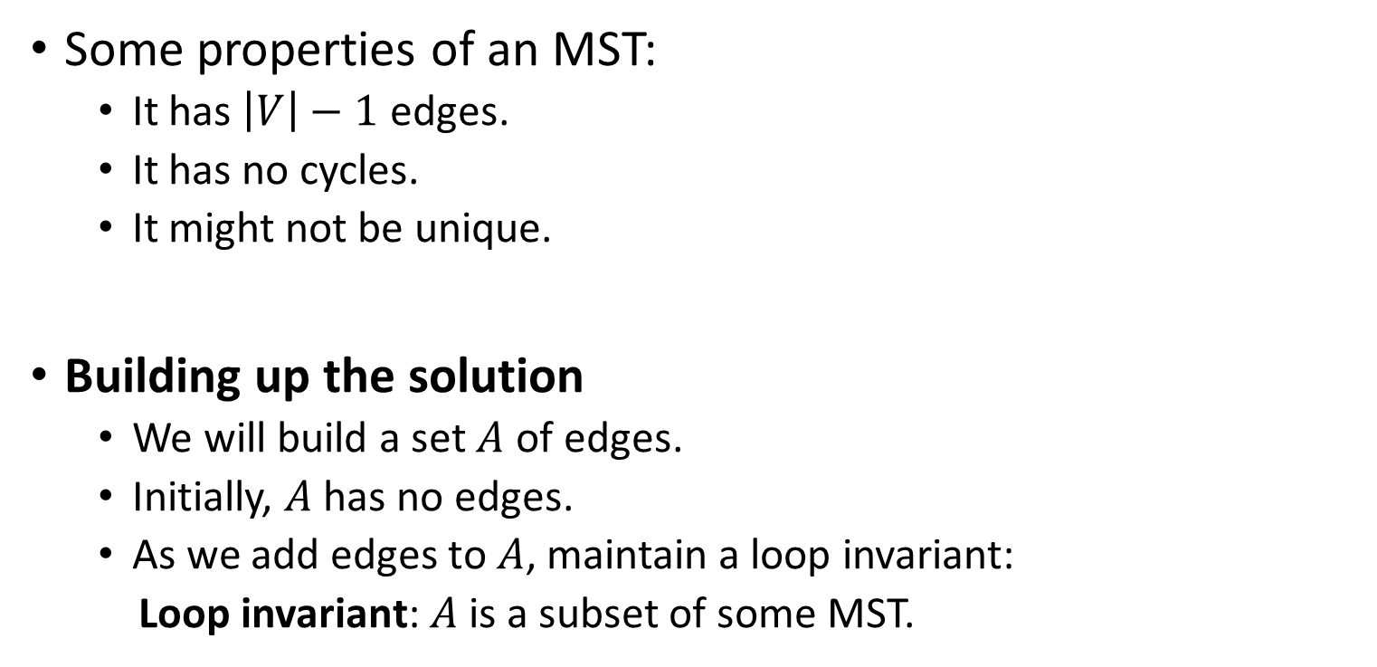
Growing a minimum spanning tree
Some properties of an MST:
It has $\left|V\right|−1$ edges.
It has no cycles.
It might not be unique.
Building up the solution
We will build a set $A$ of edges.
Initially, $A$ has no edges.
As we add edges to $A$, maintain a loop invariant:
Loop invariant: $A$ is a subset of some MST.

Slide 6

Growing a minimum spanning tree
Add only edges that maintain the invariant. If $A$ is a subset of some MST, an edge $(u,v)$ is safe for $A$ if and only if $A∪\{\left(u,v\right)\}$ is also a subset of some MST. So we will add only safe edges.
Generic MST algorithm

Slide 7

Use the loop invariant to show that this generic algorithm works.
Initialization: The empty set trivially satisfies the loop invariant.
Maintenance: Since we add only safe edges, $A$ remains a subset of some MST.
Termination: All edges added to $A$ are in an MST, so when we stop, $A$ is spanning tree that is also an MST.

Slide 8
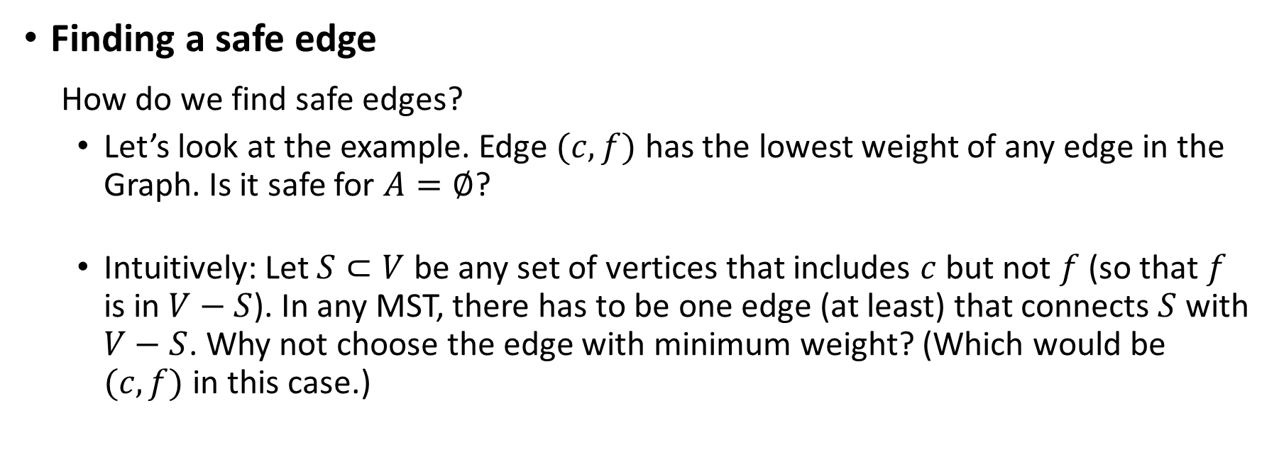
Finding a safe edge
How do we find safe edges?
Let’s look at the example. Edge $(c,f)$ has the lowest weight of any edge in the Graph. Is it safe for $A=∅$?
Intuitively: Let $S⊂V$ be any set of vertices that includes $c$ but not $f$ (so that $f$ is in $V−S$). In any MST, there has to be one edge (at least) that connects $S$ with $V−S$. Why not choose the edge with minimum weight? (Which would be $(c,f)$ in this case.)

Slide 9
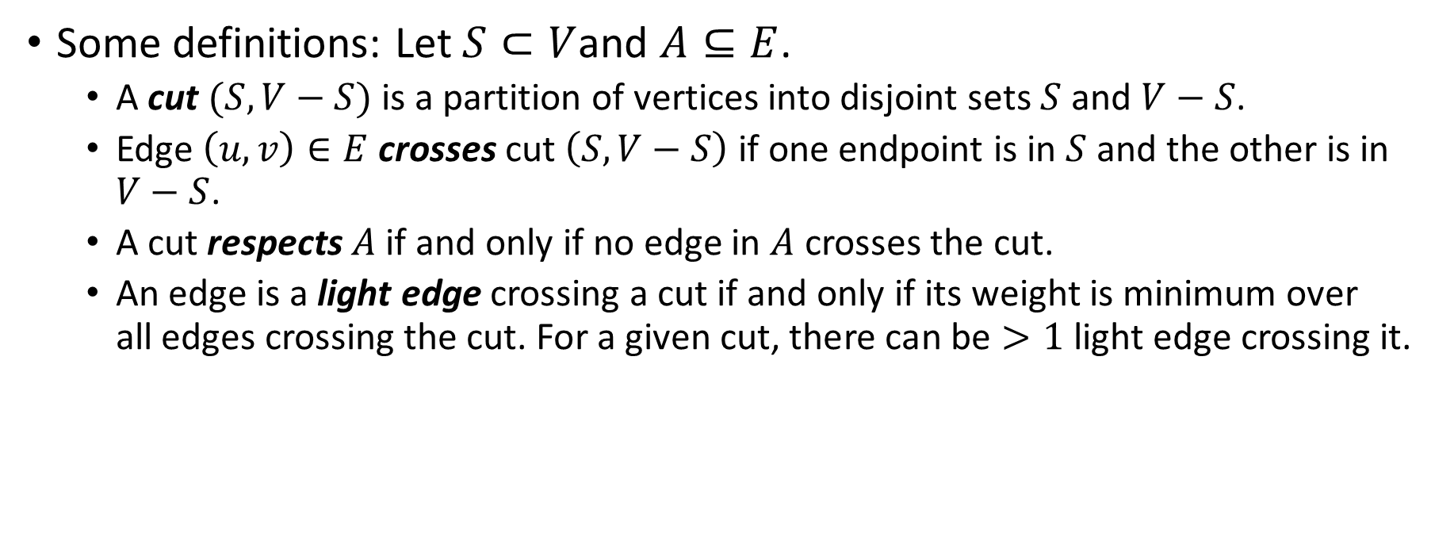
Some definitions: Let $S⊂V$and $A⊆E$.
A cut $(S,V−S)$ is a partition of vertices into disjoint sets $S$ and $V−S$.
Edge $\left(u,v\right)∈E$ crosses cut $\left(S,V−S\right)$ if one endpoint is in $S$ and the other is in $V−S$.
A cut respects $A$ if and only if no edge in $A$ crosses the cut.
An edge is a light edge crossing a cut if and only if its weight is minimum over all edges crossing the cut. For a given cut, there can be $>1$light edge crossing it.

Slide 10
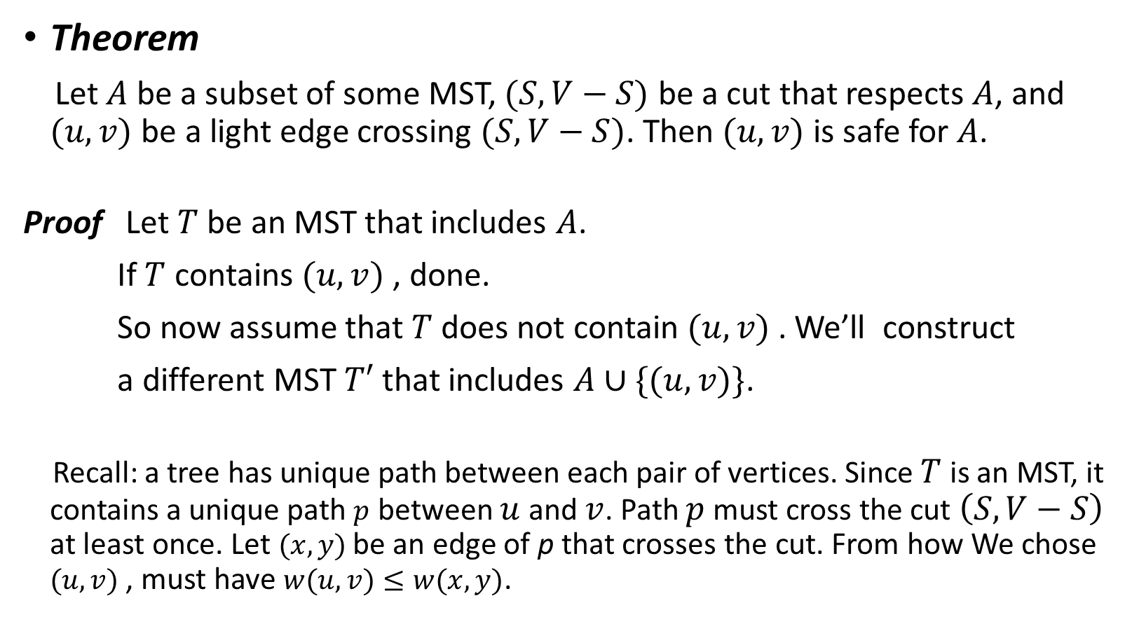
Theorem
Let $A$ be a subset of some MST, $(S,V−S)$ be a cut that respects $A$, and $(u,v)$ be a light edge crossing $(S,V−S)$. Then $(u,v)$ is safe for $A$.
Proof Let $T$ be an MST that includes $A$.
If $T$ contains $(u,v)$ , done.
So now assume that $T$ does not contain $(u,v)$ . We’ll construct
a different MST $T′$ that includes $A∪\{(u,v)\}$.
Recall: a tree has unique path between each pair of vertices. Since $T$ is an MST, it contains a unique path $p$ between $u$ and $v$. Path $p$ must cross the cut $\left(S,V−S\right)$ at least once. Let $(x,y)$ be an edge of p that crosses the cut. From how We chose $(u,v)$ , must have $w(u,v)≤w(x,y)$.

Slide 11

[Except for the dashed edge $(u,v)$ all edges shown are in $T$. $A$ is some
subset of the edges of $T$, but $A$ cannot contain any edges that cross the cut $(S,V−S)$, since this cut respects $A$. Red edges are the path $p$.]
S
u
x
v
y
V−S

Slide 12
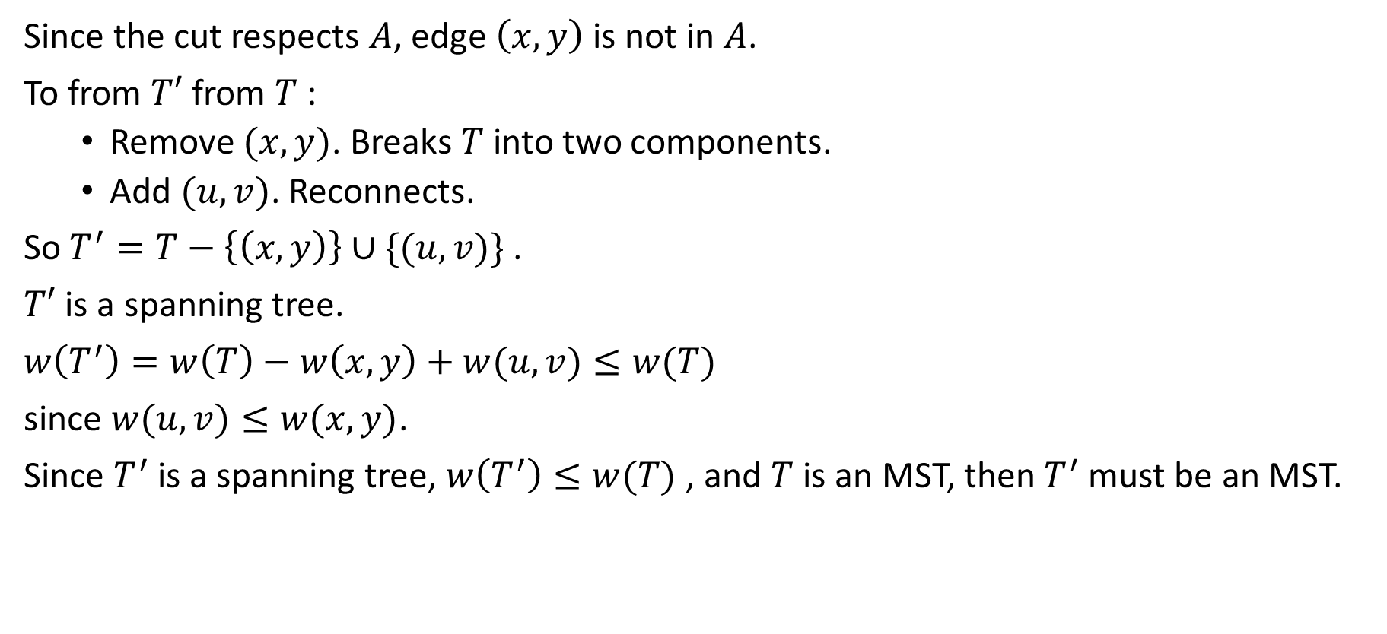
Since the cut respects $A$, edge $\left(x,y\right)$ is not in $A$.
To from $T′$ from $T$:
Remove $(x,y)$. Breaks $T$into two components.
Add $(u,v)$. Reconnects.
So $T^{′}=T−\left\{\left(x,y\right)\right\}∪\{(u,v)\}$.
$T′$ is a spanning tree.
$w\left(T^{′}\right)=w\left(T\right)−w\left(x,y\right)+w(u,v)≤w(T)$
since $w(u,v)≤w(x,y)$.
Since $T^{′}$is a spanning tree, $w\left(T^{′}\right)≤w(T)$, and $T$ is an MST, then $T^{′}$must be an MST.

Slide 13

Need to show that $(u,v)$is safe for $A$:
$A⊆T$and $(x,y)∉A⟹A⊆T′$
$A∪\{(u,v)\}⊆T′$
Since $T′$is an MST, $(u,v)$is safe for $A$.

Slide 14
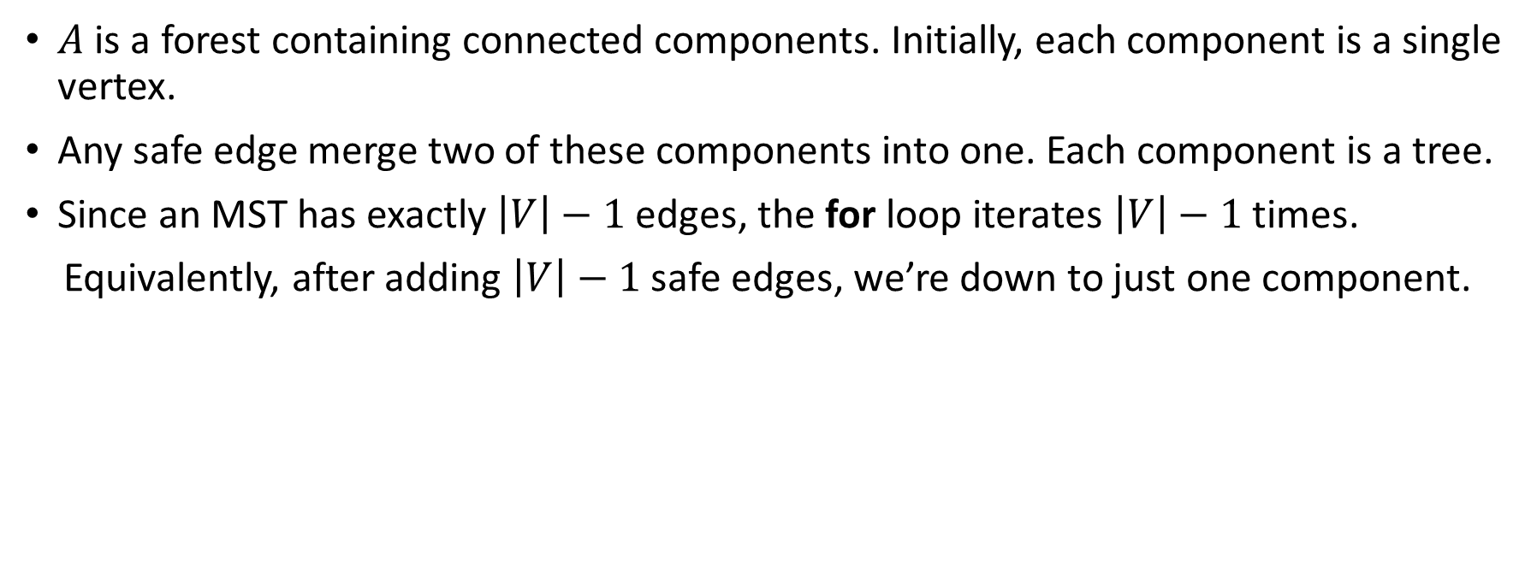
GENERIC-MST:
$A$ is a forest containing connected components. Initially, each component is a single vertex.
Any safe edge merge two of these components into one. Each component is a tree.
Since an MST has exactly $\left|V\right|−1$edges, the for loop iterates $\left|V\right|−1$times.
Equivalently, after adding $\left|V\right|−1$safe edges, we’re down to just one component.

Slide 15
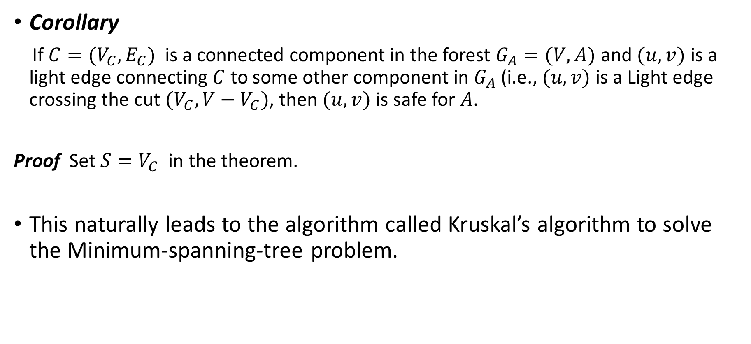
Corollary
If $C=(V_{C},E_{C})$ is a connected component in the forest $G_{A}=(V,A)$ and $(u,v)$ is a light edge connecting $C$ to some other component in $G_{A}$ (i.e., $(u,v)$ is a Light edge crossing the cut $(V_{C},V−V_{C})$, then $(u,v)$ is safe for $A$.
Proof Set $S=V_{C}$ in the theorem.
This naturally leads to the algorithm called Kruskal’s algorithm to solve the Minimum-spanning-tree problem.

Slide 16
Kruskal’s algorithm

Slide 17
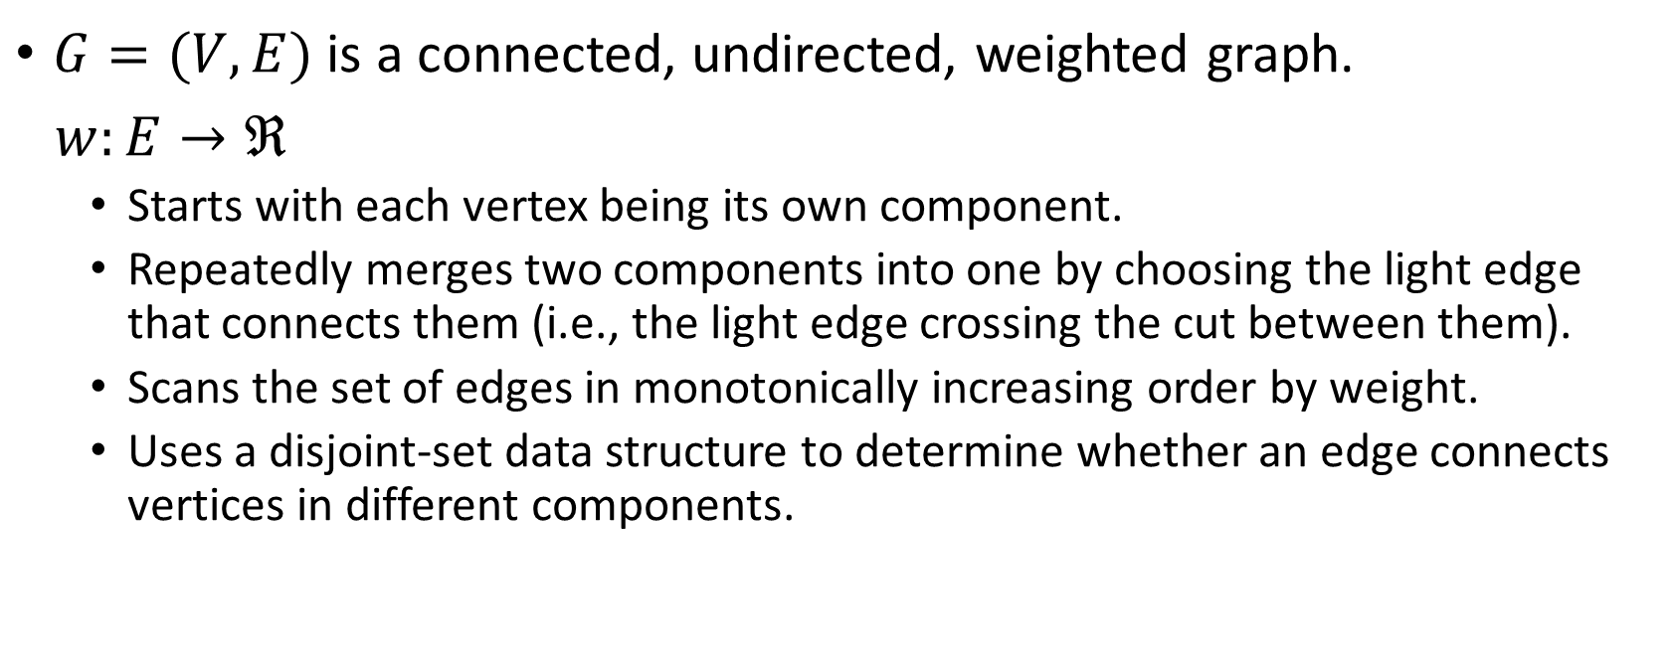
Kruskal’s algorithm
$G=(V,E)$ is a connected, undirected, weighted graph.
$w:E→ℜ$
Starts with each vertex being its own component.
Repeatedly merges two components into one by choosing the light edge that connects them (i.e., the light edge crossing the cut between them).
Scans the set of edges in monotonically increasing order by weight.
Uses a disjoint-set data structure to determine whether an edge connects vertices in different components.

Slide 19
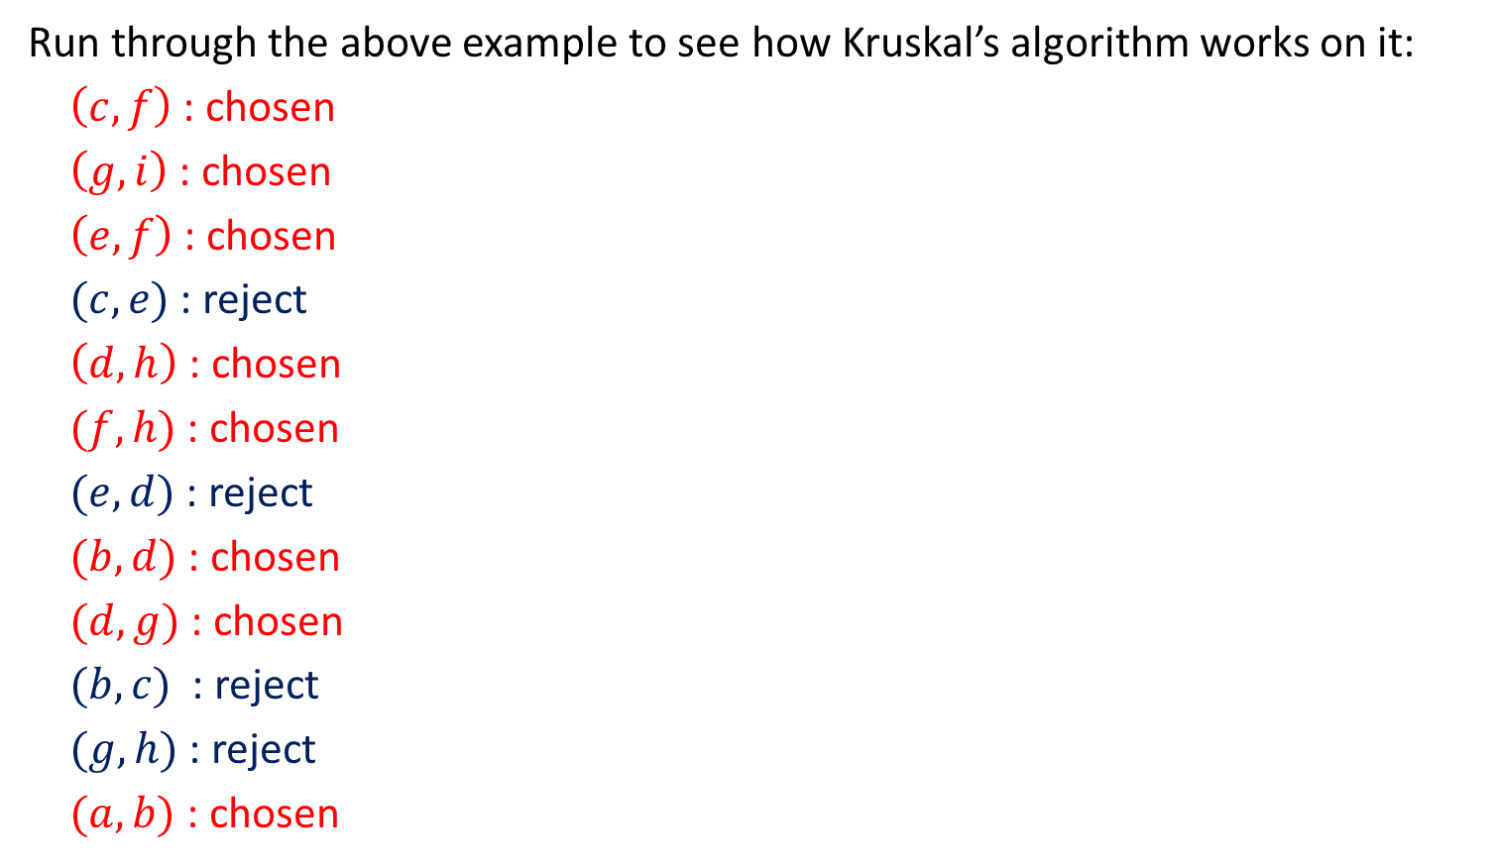
Run through the above example to see how Kruskal’s algorithm works on it:
$\left(c,f\right)$: chosen
$\left(g,i\right)$: chosen
$\left(e,f\right)$: chosen
$(c,e)$: reject
$\left(d,h\right)$: chosen
$(f,h)$: chosen
$(e,d)$: reject
$(b,d)$: chosen
$(d,g)$: chosen
$(b,c)$ : reject
$(g,h)$: reject
$(a,b)$: chosen
8
8
b
d
g
10
2

7
5
a
9

e

9
i
3
3

12
11
c
f
h
1
6

Slide 20
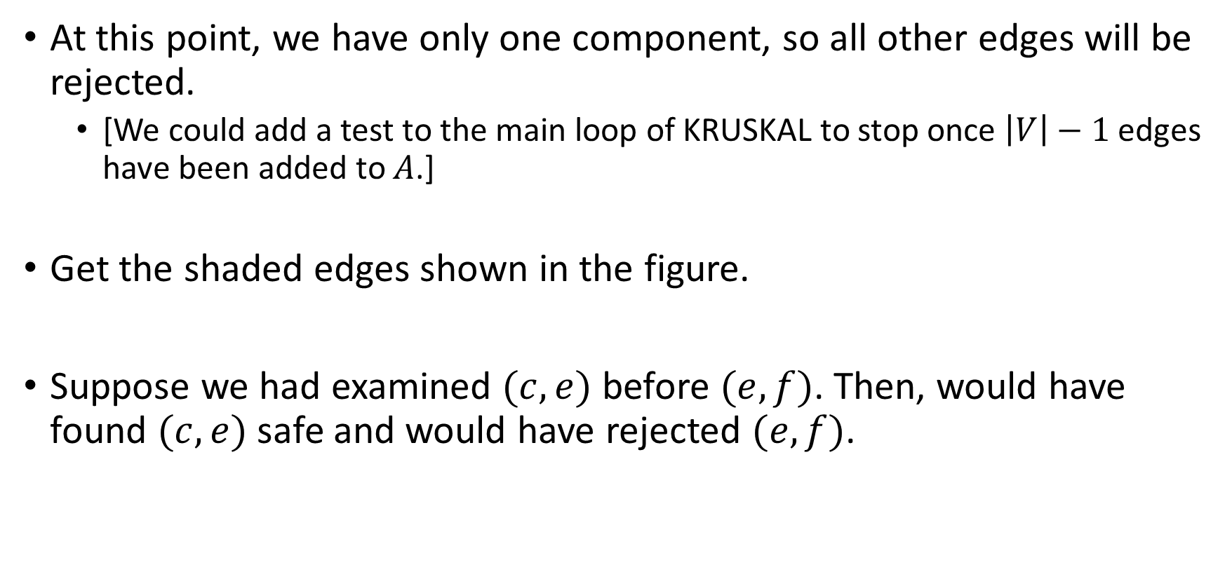
At this point, we have only one component, so all other edges will be rejected.
[We could add a test to the main loop of KRUSKAL to stop once $\left|V\right|−1$edges have been added to $A$.]
Get the shaded edges shown in the figure.
Suppose we had examined $(c,e)$ before $(e,f)$. Then, would have found $(c,e)$ safe and would have rejected $(e,f)$.

Slide 21

Analysis
Initialize $A$: $O(1)$
First for loop: $\left|V\right|$ MAKE-SETS
Sort $E:$ $O(E lg E)$
Second for loop: $O\left(E\right)$ FIND-SETS and UNIONS

Slide 22
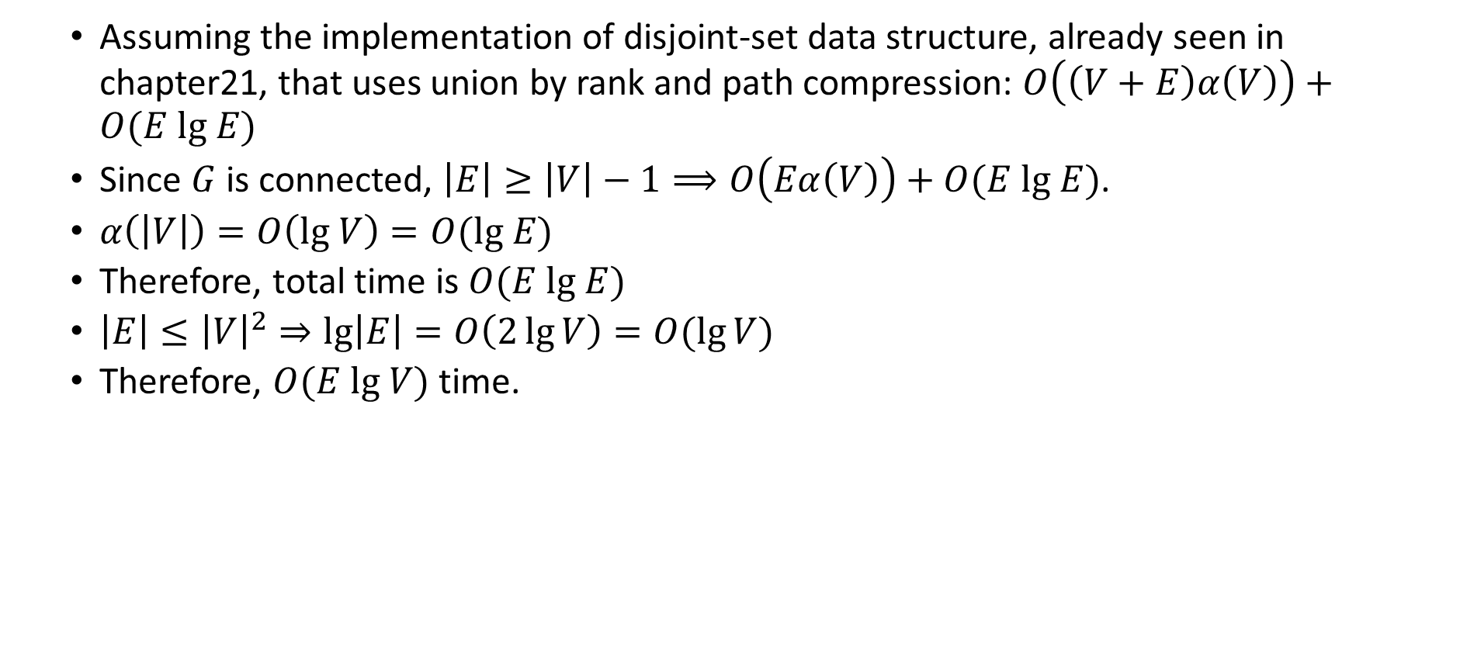
Assuming the implementation of disjoint-set data structure, already seen in chapter21, that uses union by rank and path compression: $O\left(\left(V+E\right)α\left(V\right)\right)+O(E lg E)$
Since $G$ is connected, $\left|E\right|≥\left|V\right|−1⟹O\left(Eα\left(V\right)\right)+O(E lg E)$.
$α\left(\left|V\right|\right)=O\left(lg V\right)=O(lg E)$
Therefore, total time is $O(E lg E)$
$\left|E\right|≤{\left|V\right|}^{2}⇒lg\left|E\right|=O\left(2\lg{V}\right)=O(\lg{V})$
Therefore, $O(E lg V)$time.

Slide 23
Prim’s algorithm

Slide 24



Prim’s algorithm
Builds one tree, so $A$ is always a tree.
Starts from an arbitrary “root” $r$.
At each step, find a light edge crossing cut$(V_{A},V−V_{A})$, where $V_{A}$= vertices that $A$ is incident on. Add this edge to $A$.
$$V_{A}$$
$$V−V_{A}$$
Light edge
[Edges of A are shaded.]

Slide 25
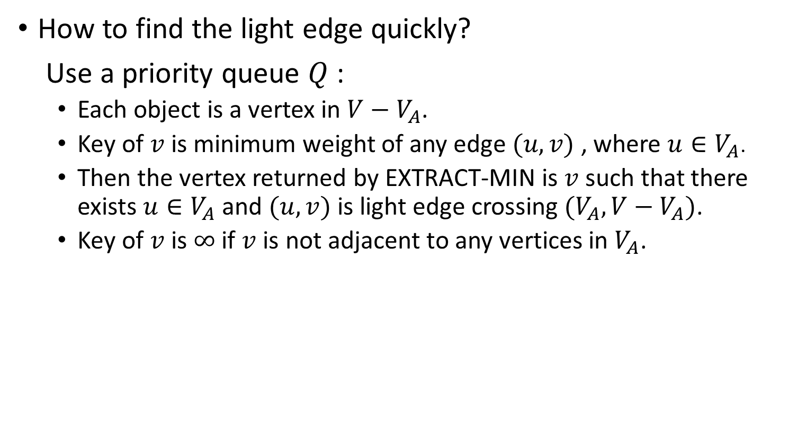
How to find the light edge quickly?
Use a priority queue $Q$:
Each object is a vertex in $V−V_{A}$.
Key of $v$ is minimum weight of any edge $(u,v)$ , where $u∈V_{A}$.
Then the vertex returned by EXTRACT-MIN is $v$ such that there exists $u∈V_{A}$ and $(u,v)$ is light edge crossing $(V_{A},V−V_{A})$.
Key of $v$ is $∞$ if $v$ is not adjacent to any vertices in $V_{A}$.

Slide 26

The edges of $A$ will form a rooted tree with root $r$:
$r$ is given as an input to the algorithm, but it can be any vertex.
Each vertex knows its parent in the tree by the attribute $v.π=parent of v$ and $v.π=NIL if v=r$ or $v$ has no parent.
As algorithm progresses, $A=\{\left(v,v.π \right):v∈V−\left\{r\right\}−Q\}$.
At termination, $V_{A}=V⟹Q=∅$, so MST is $=\{\left(v,v.π \right):v∈V−\left\{r\right\}$}

Slide 28

Run through the above example to see how Prim’s algorithm works on it:
Vertex $c$ has been chosen as a starting point.
8
8
b
d
g
10
2
7
5
a
e
h
f
i
c
a
a
g
b
d
i
h
g
b
a
i
i
a
9
e
9
i
3
10
3
6
5
11
6
∞
1
∞
0
∞
∞
12
8
2
8
8
3
2
12
11
h
e
g
d
d
h
a
a
a
a
a
6
a
3
9
5
7
6
12
12
12
12
12
e
12
b
b
b
b
a
a
a
c
3
c
9
∞
∞
∞
12
12
∞
0
b
∞
a
b
8
a
12
b
8
12
g
a
8
a
8
12
b
8
12
a
c
f
h
12
1
6
root
i
g
g
d
d
d
g
d
g
d
d
d
d
g
g
g
g
i
g
i
∞
∞
11
9
∞
7
9
9
9
9
9
9
∞
∞
∞
∞
∞
∞
∞
∞
∞
∞
∞
9
3
∞
∞
∞
∞
1
∞
∞
∞
∞
∞
∞
∞
11
∞
11
(c, f) : chosen
(d, g) : chosen
b
b
b
b
b
b
i
i
i
b
i
e
e
e
e
i
f
f
f
f
(e, f) : chosen
(g, i) : chosen
∞
∞
∞
∞
∞
∞
∞
∞
(f, h) : chosen
(b, d) : chosen
h
h
h
h
h
i
i
i
(d, h) : chosen
(a, b) : chosen

Slide 29

Analysis
Depends on how the priority queue is implemented:
Suppose $Q$ is a binary heap.
Initialize $Q$ and first for loop: $O(V\lg{V})$ and $O(V)$
Decrease key of$r$: $O(\lg{V})$
while loop: $\left|V\right|$ EXTRACT-MIN calls
$⇒O(V\lg{V})$
≤ $\left|E\right|$DECREASE-KEY calls
$⇒O(E\lg{V})$
Total: $O(E\lg{V})$

